Slide 1
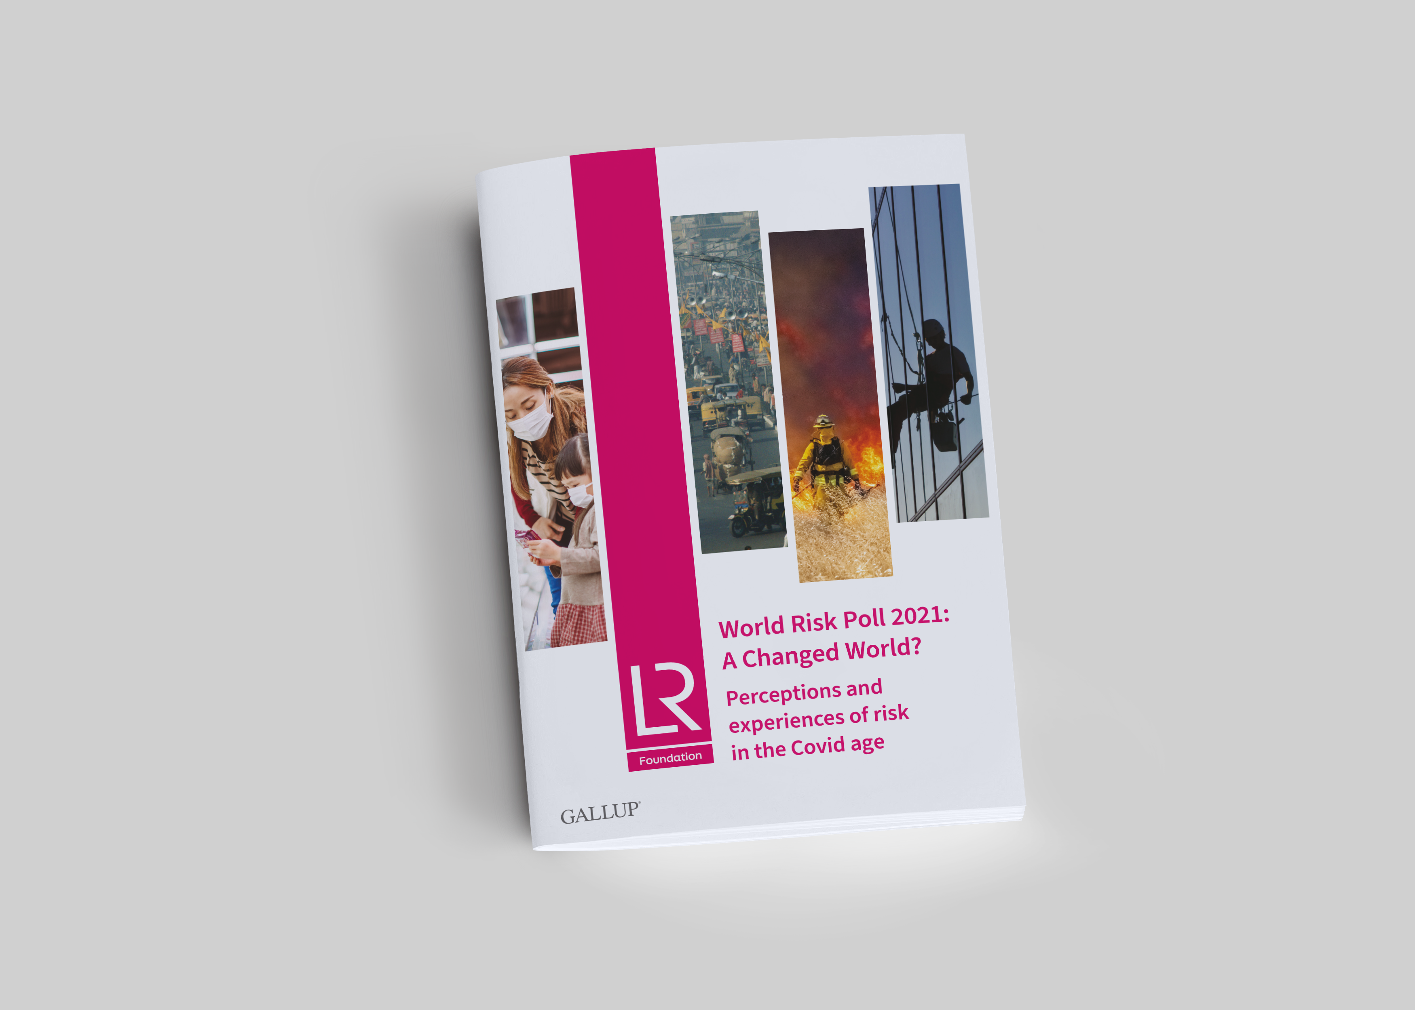
Call for Proposals
World Risk Poll 2021:
A Changed World?
Perceptions and experiences of risk in the Covid Age
lrfworldriskpoll.com
@LR_Foundation // #WorldRiskPoll

Slide 2
Lloyd’s Register Foundation
An independent global charity with a mission to engineer a safer world
  Unique structure and sole shareholder of Lloyd’s Register Group
  Work to reduce risk and enhance the safety of critical infrastructure
  Award grants and support work which helps us deliver our charitable mission
  Aim to improve safety through interventions that are driven by evidence of what works
We focus on the biggest safety challenges: Safety at sea, safety of digital systems, safety for a sustainable future, safety of food, skills for safety, safety of physical infrastructure, public understanding of risk.

Slide 3
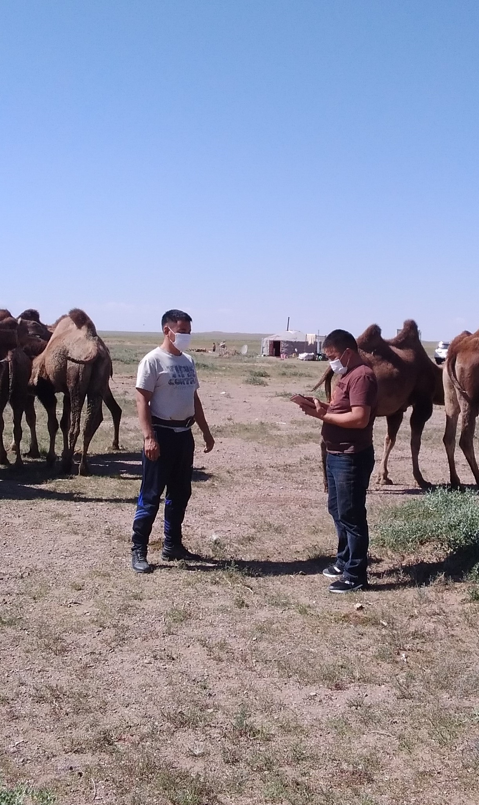
The Lloyd’s Register Foundation World Risk Poll
121 countries, 125000 interviews
  Assessing perception and experience of risk
  In places where little or no official data on safety exists
  Disaster resilience, violence & harassment at work, data privacy & artificial intelligence
2019 > 2021
  Build on existing data
  What changed, and what didn’t?
  Impact of Covid-19 on people’s sense of safety

Slide 4
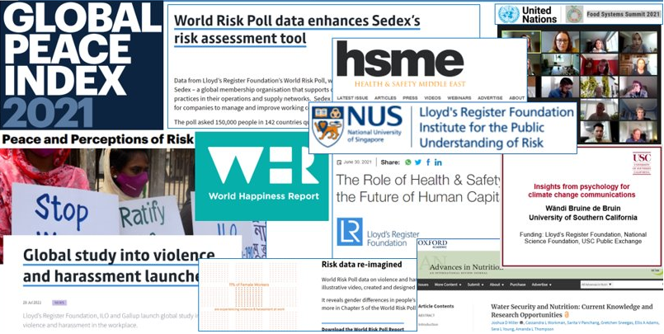
World Risk Poll 2019 Projects

Slide 5
World Risk Poll 2021 - Call for Proposals
Foundation strategic aim to maximise the impact of the Poll data
First in a series of 4 calls linked to each 2021 World Risk Poll focus area
  Perceptions and experiences of risk in the Covid Age
  Global resilience - perceptions and experiences of disaster preparedness
  Perceptions of harm from AI and misuse of personal data
  Violence and harassment at work
Grant funding available for impactful research and interventions that utilise the Poll data and aim to improve global safety
Budget: upper limit of £250,000 for most projects but the Foundation may fund one larger, high impact project with a budget of up to £750,000.
Deadline of 31/12/2022 for applications
Prospective applicants must first register interest on Flexigrant

Slide 6
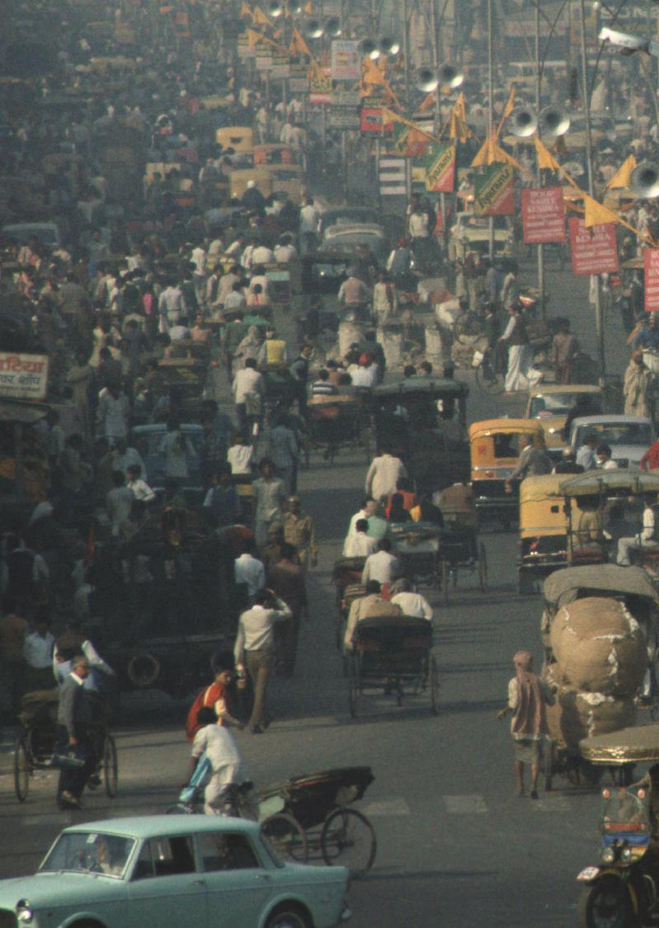
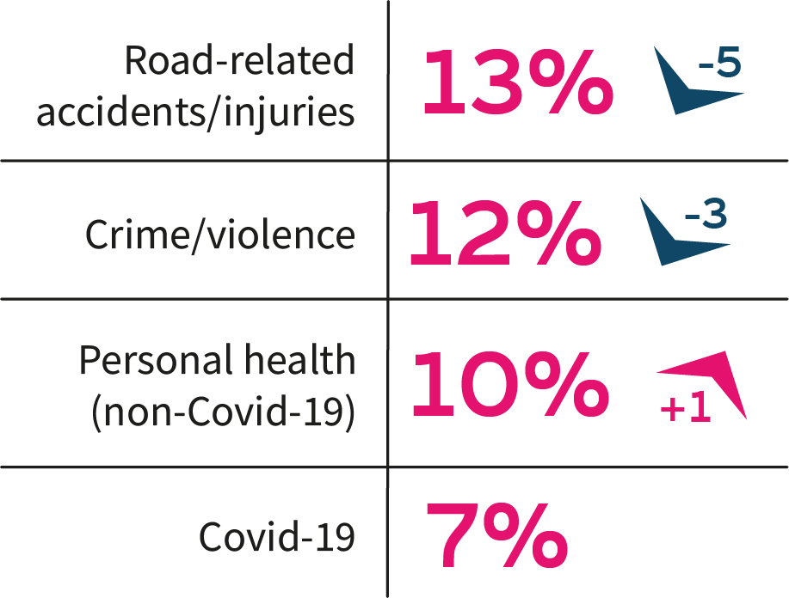
We face many different risks in our daily lives
Greatest risk to safety in your own words

Slide 7
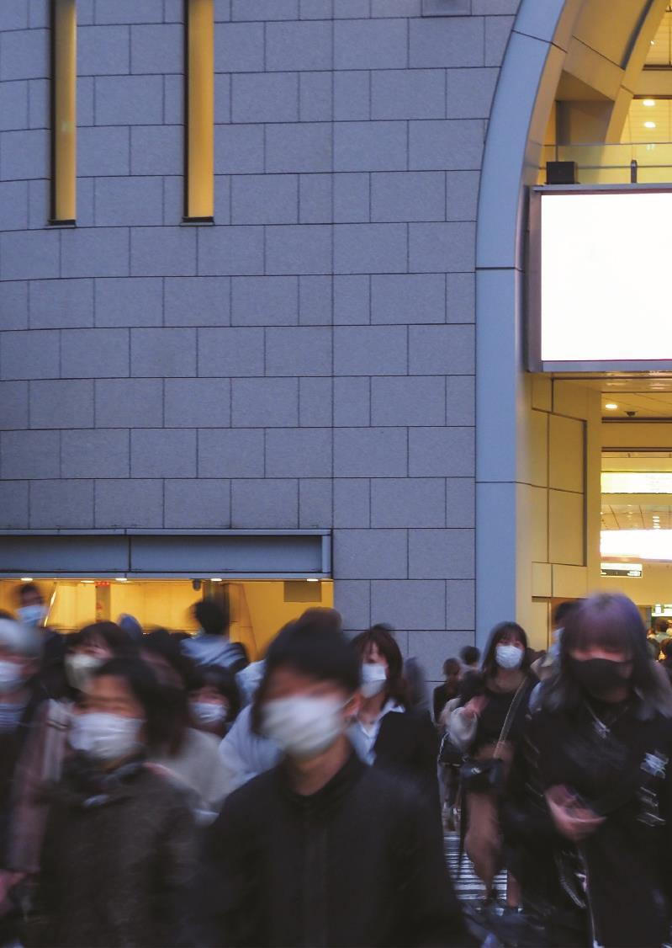
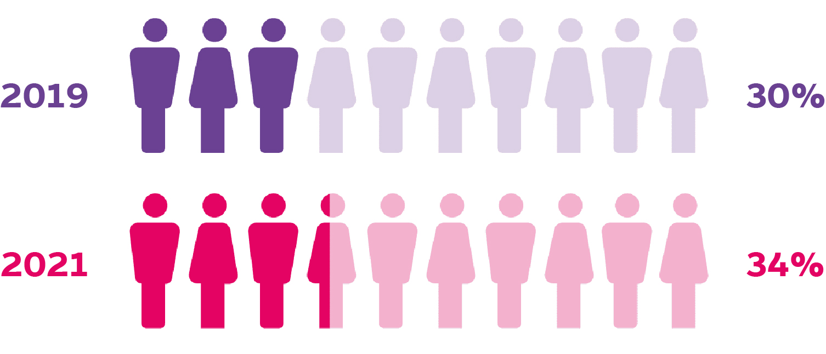
Globally, more people feel less safe than they did five years previously
How safe do you feel compared to five years ago?

Slide 8
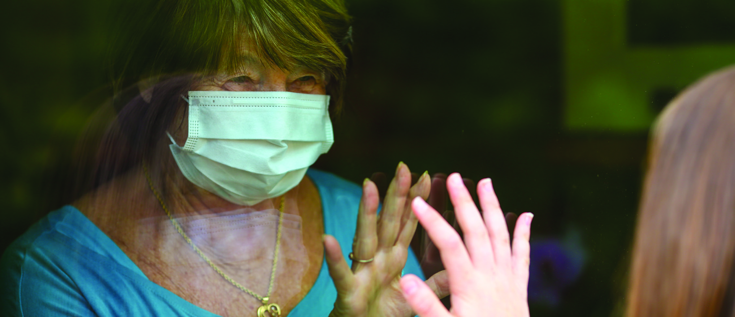
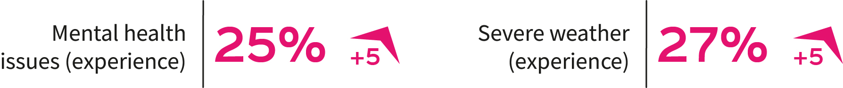
Serious harm from mental health issues and severe weather increased
Have you or someone you know experienced serious harm from…

Slide 9
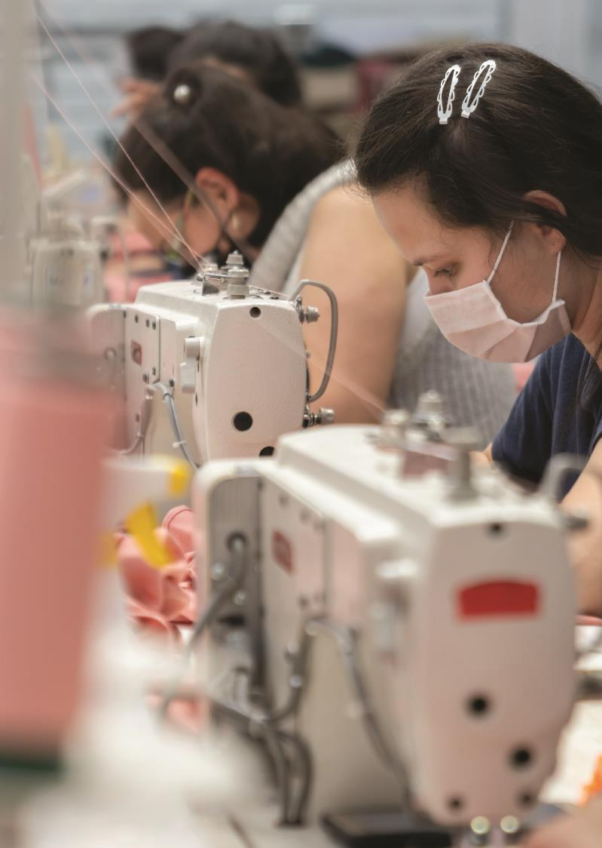
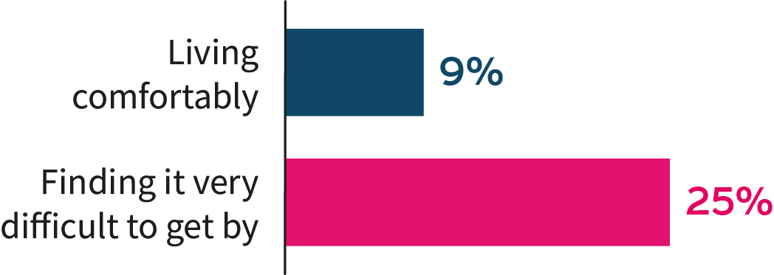
People on low incomes experience more serious harm at work
Have you or someone you know experienced
serious harm from the work you do?

Slide 10
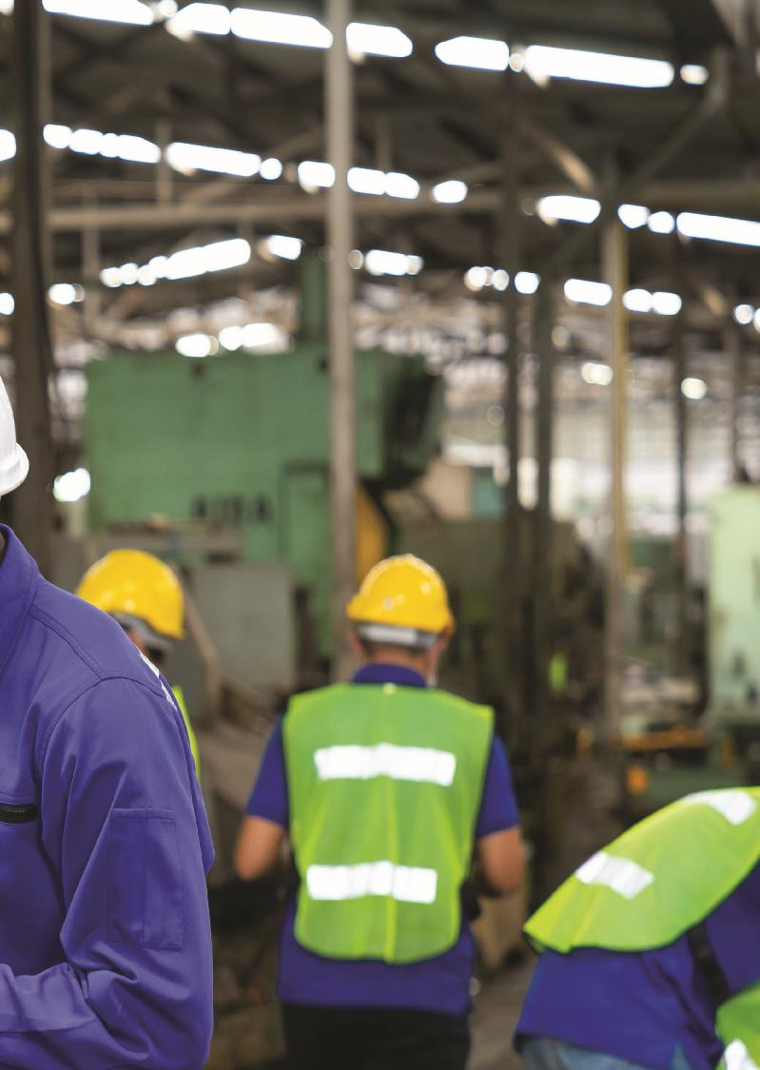
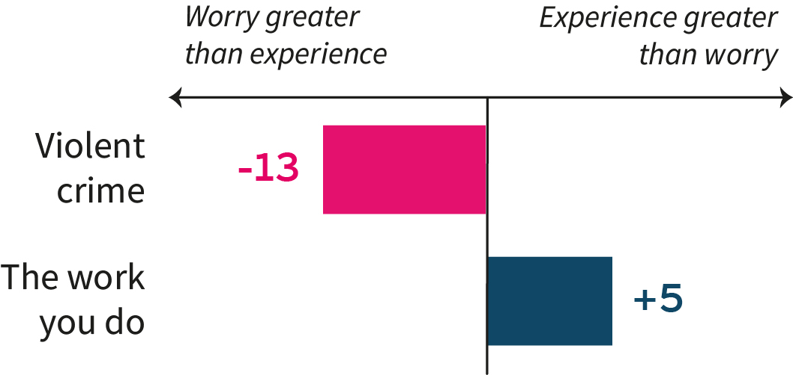
We can use the worry and experience gap to improve safety
Have you, or someone you know, experienced serious harm from…
How worried are you that… could cause you serious harm

Slide 11
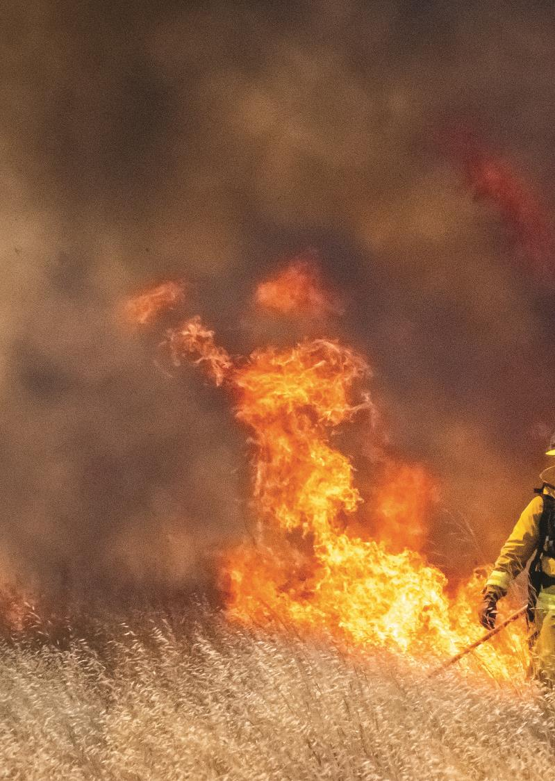
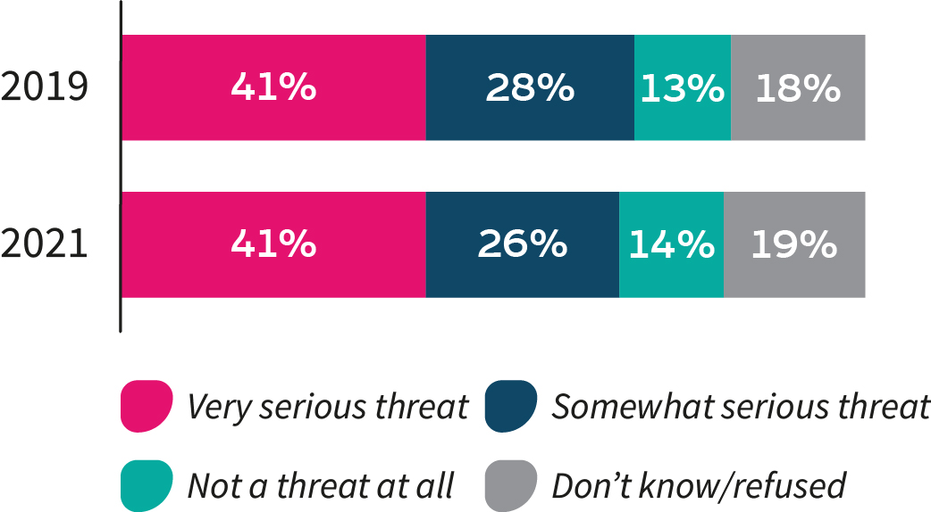
Climate change perceptions unchanged – in spite of competing risks
Do you think that climate change is a threat?

Slide 12
Questions

Slide 13
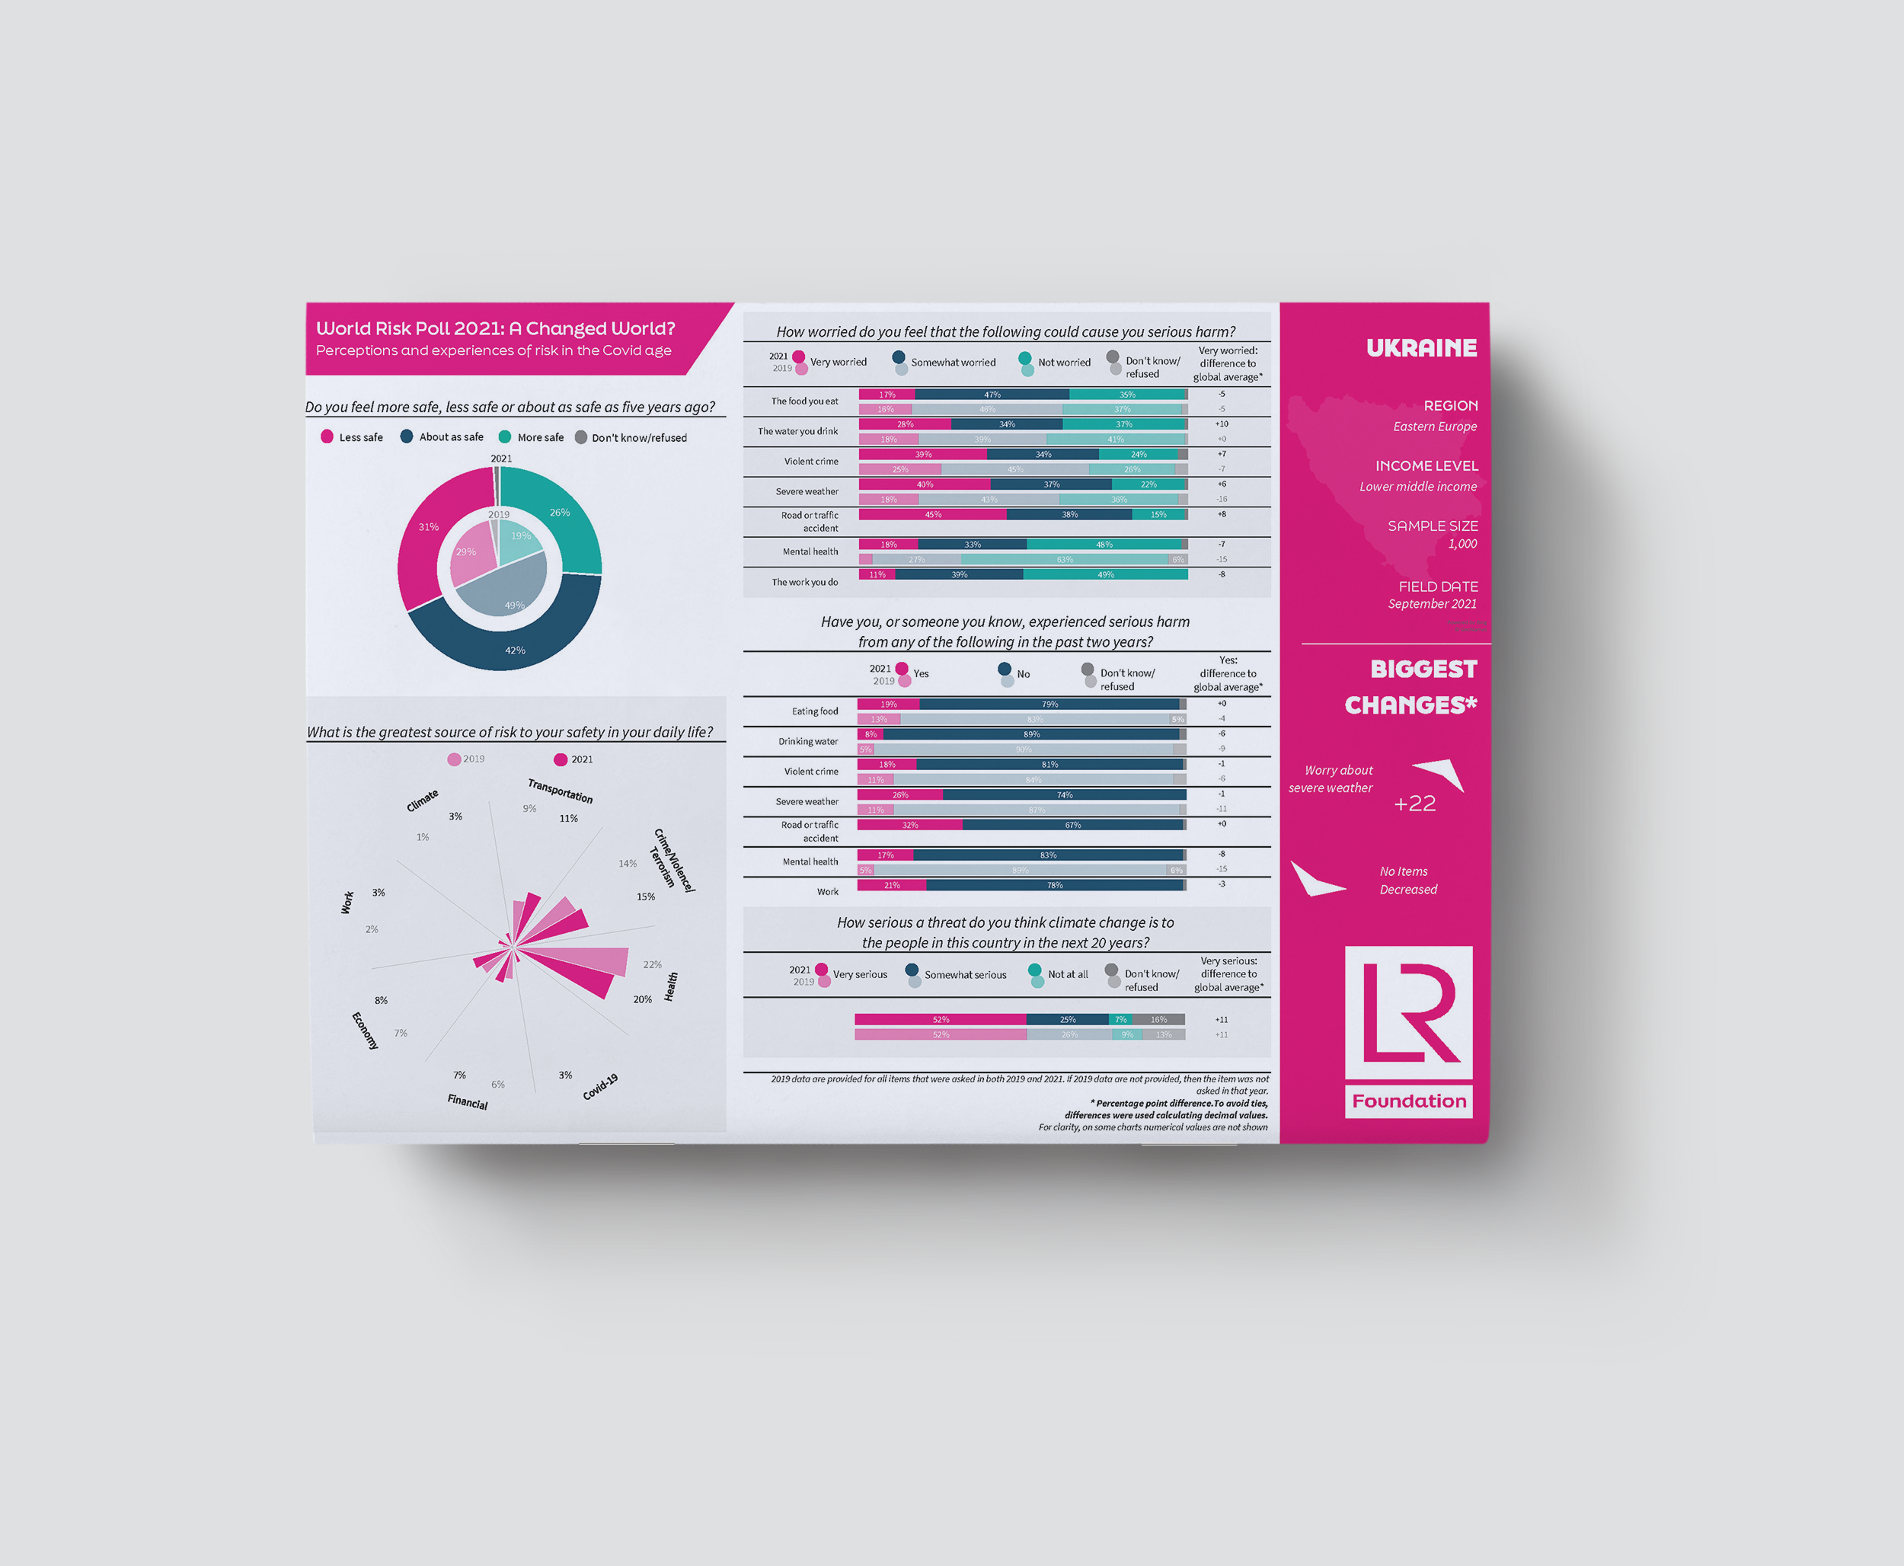
lrfworldriskpoll.com
Explore the poll – stories and visual snapshots
Download the full dataset
Apply for funding to turn the World Risk Poll into action
Queries to worldriskpoll@lrfoundation.org.uk
lrfworldriskpoll.com
@LR_Foundation // #WorldRiskPoll

Slide 14
Appendix I - questions used in presentation
Slide 3 – In your own words, what is the greatest source of RISK TO YOUR SAFETY in your daily life?
Slide 4 – Overall, compared to five years ago, do you feel more safe, less safe, or about as safe as you did five years ago?
Slide 5 – Have you or someone you PERSONALLY know, EXPERIENCED serious harm from any of the following things in the past TWO years? (Mental health issues, sever weather events such as floods or violent storms)
Slide 6 – Have you or someone you PERSONALLY know, EXPERIENCED serious harm from any of the following things in the past TWO years? (Work)
Slide 7 – Have you or someone you PERSONALLY know, EXPERIENCED serious harm from any of the following things in the past TWO years? (Violent crime, the work you do)
Slide 7 – In general, how WORRIED are you that each of the following things could cause you serious harm? Are you very worried, somewhat worried, or not worried? (Violent crime, the work you do)
Slide 8 - Do you think that climate change is a very serious threat, a somewhat serious threat, or not a threat at all to the people in this country in the next 20 years? If you don't know, please just say so.

