Slide 1

Call for Proposals (4 of 4)
World Risk Poll 2021:
Safe at Work?
Global experiences of violence and harassment
lrfworldriskpoll.com
@LR_Foundation // #WorldRiskPoll

Slide 2
Lloyd’s Register Foundation
An independent global charity with a mission to engineer a safer world
  Unique structure and sole shareholder of Lloyd’s Register Group
  Work to reduce risk and enhance the safety of critical infrastructure and safety of people
  Award grants and support work which helps us deliver our charitable mission
  Aim to improve safety through interventions that are driven by evidence of what works
We focus on the biggest safety challenges: Safety at sea, safety of digital systems, safety for a sustainable future, safety of food, skills for safety, safety of physical infrastructure, public understanding of risk.

Slide 3
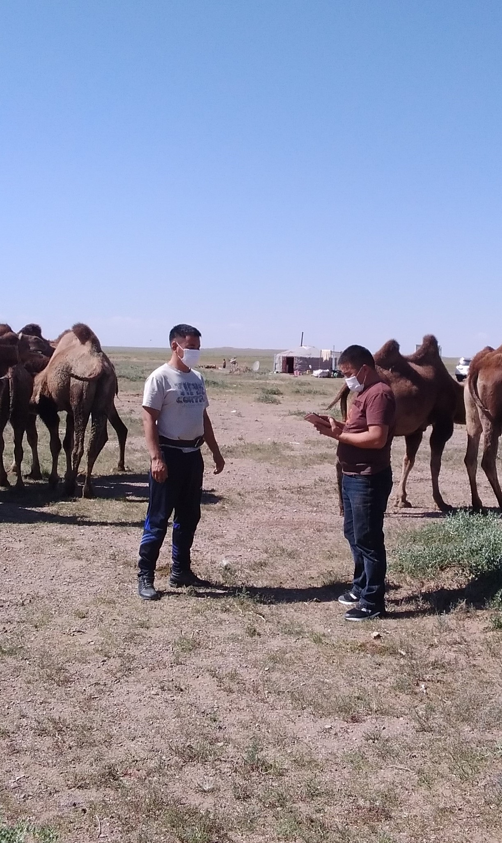
The Lloyd’s Register Foundation World Risk Poll
First global study of worry about, and harm from, risks to people’s safety.
2nd edition of the WRP, based on around 125,000 interviews conducted by Gallup in 121 countries during 2021.
includes places where little or no official data on safety and risk exists, and so constitutes a unique resource for defining the nature and scale of safety challenges across the world, as reported first-hand by those who experience them.
offers a direct comparison between how people around the world perceive risks and how they experience them; understanding these differences can be crucial to informing effective risk management policies and communications

Slide 4
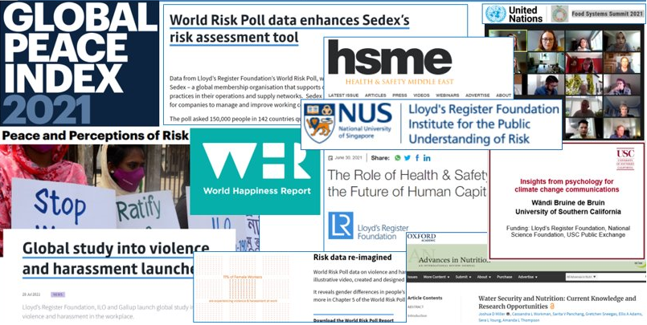
World Risk Poll 2019 Projects

Slide 5
World Risk Poll 2021 - Call for Proposals
Foundation strategic aim to maximise the impact of the Poll data
Last in a series of 4 calls linked to each 2021 World Risk Poll focus area
  Changed World? Perceptions and experiences of risk in the Covid Age (call announcement)
  Resilient World? - perceptions and experiences of disaster preparedness (call announcement)
  Digital World - Perceptions of harm from AI and misuse of personal data (call announcement)
  Safe at Work? Violence and harassment at work (call announcement)
Grant funding available for impactful research and interventions that utilise the Poll data and aim to improve global safety
Budget: We expect that the typical budgets for the proposed projects may range between £250,000 and £750,000 but we are also open to receiving applications for projects outside this range, as appropriate to the type and scale of the intervention proposed.
Deadline of 13/02/2023 for Registering Interest;
Deadline of 28/02/2023 for applications from all four calls
Prospective applicants must first register interest on Flexigrant

Slide 6
Demonstrate a tangible link with the World Risk Poll dataset
e.g. addressing an issue which affects a specific community that has been identified by the Poll
e.g. embedding the Poll data in the proposed work
Possible outcomes for projects which practically apply the Poll findings through the development of new interventions or by strengthening existing ones.
e.g., utilise WRP data to support early intervention from policymakers and employers to prevent recurrence; use data on who does and doesn’t report their experiences of violence and harassment, who to, and if not, why not.
Similarly, research projects may aim to address data gaps or support hypotheses through secondary analysis of the Poll data and/or to use alongside other relevant data. An important output could be the provision of evidence, disseminated to stakeholders, which motivates action. For example, research projects which find robust evidence for how and why particular demographics are most impacted by safety challenges, that effectively communicate findings to relevant bodies, and consequently influence improvements to public risk information.

Slide 7
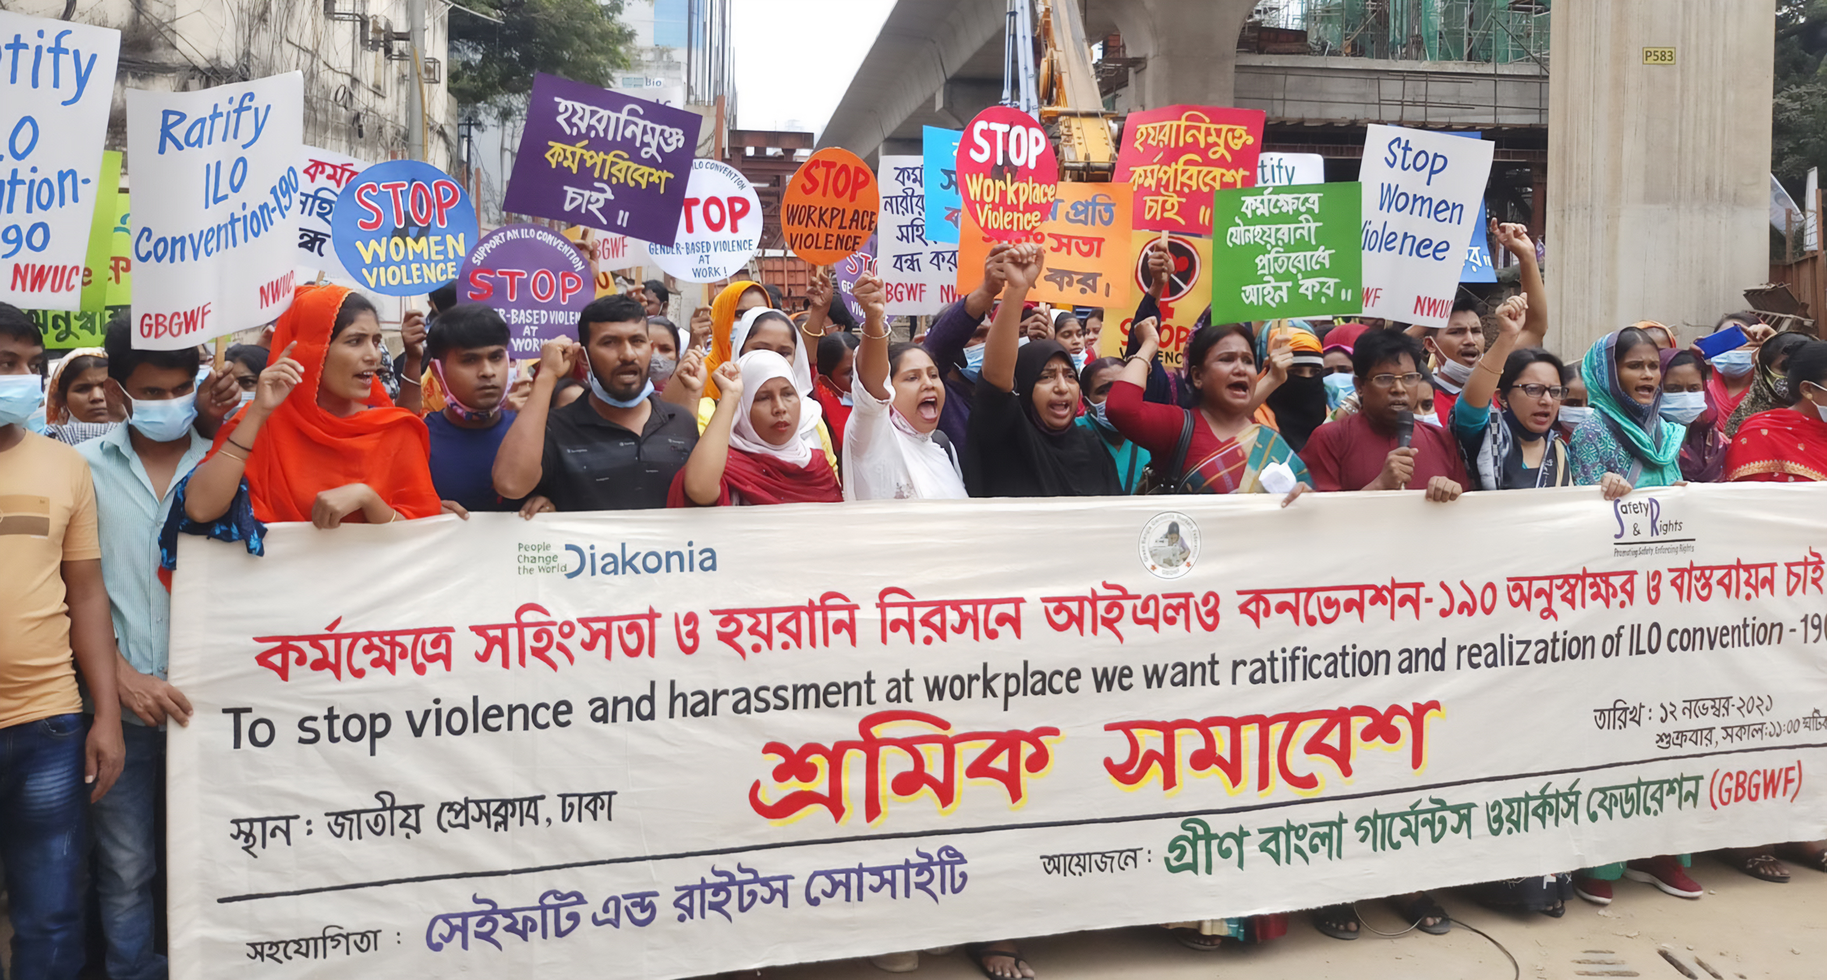
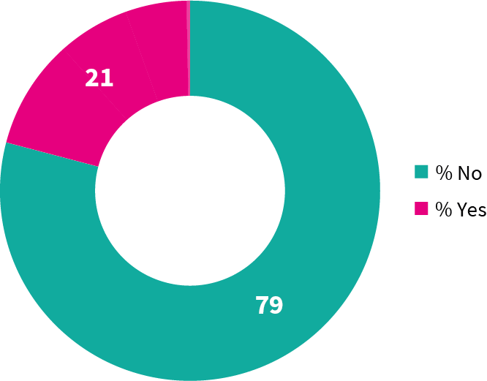
Violence and harassment at work remains a significant problem globally
Percentage of people who have ever worked who reported experience of any form of violence and harassment at work

Slide 8

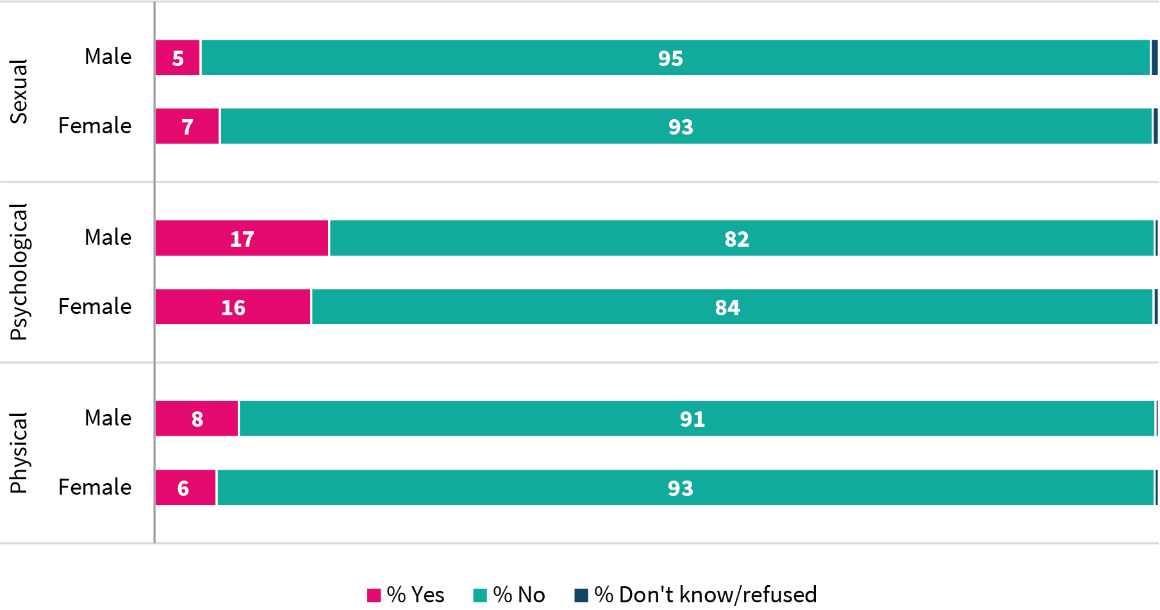
Psychological harassment – such as insults, threats, bullying or intimidation – is the most common form of abuse globally
Percentage of people who reported experience of violence and harassment at work, by type experienced and sex

Slide 9
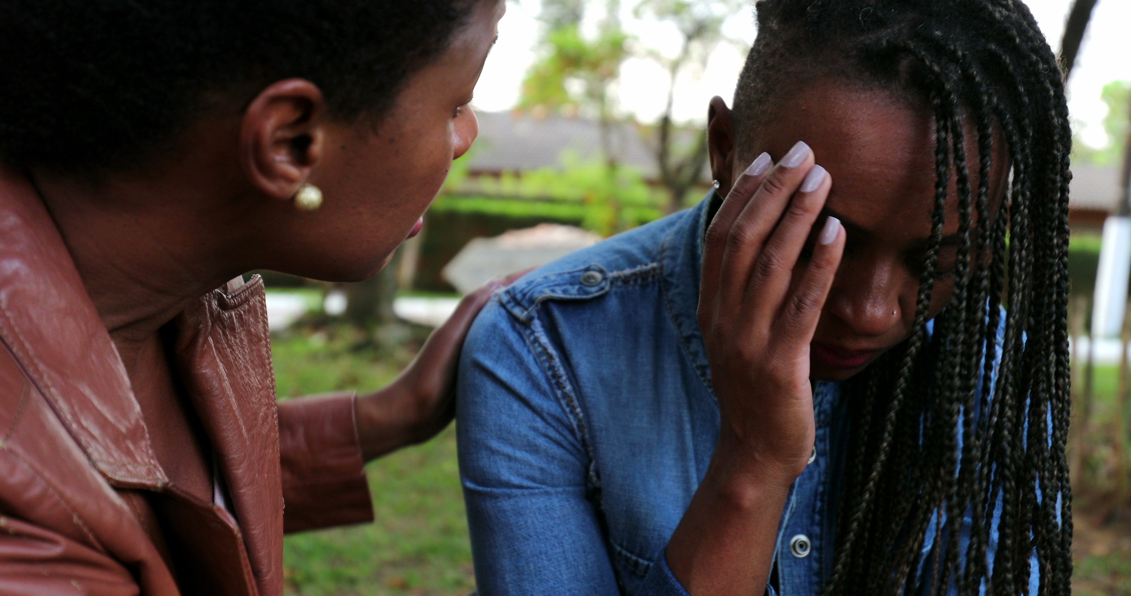

People often experience multiple forms of violence and harassment in the workplace
Percentage of people who had reported experience of violence and harassment at work, by number of forms experienced

Slide 10
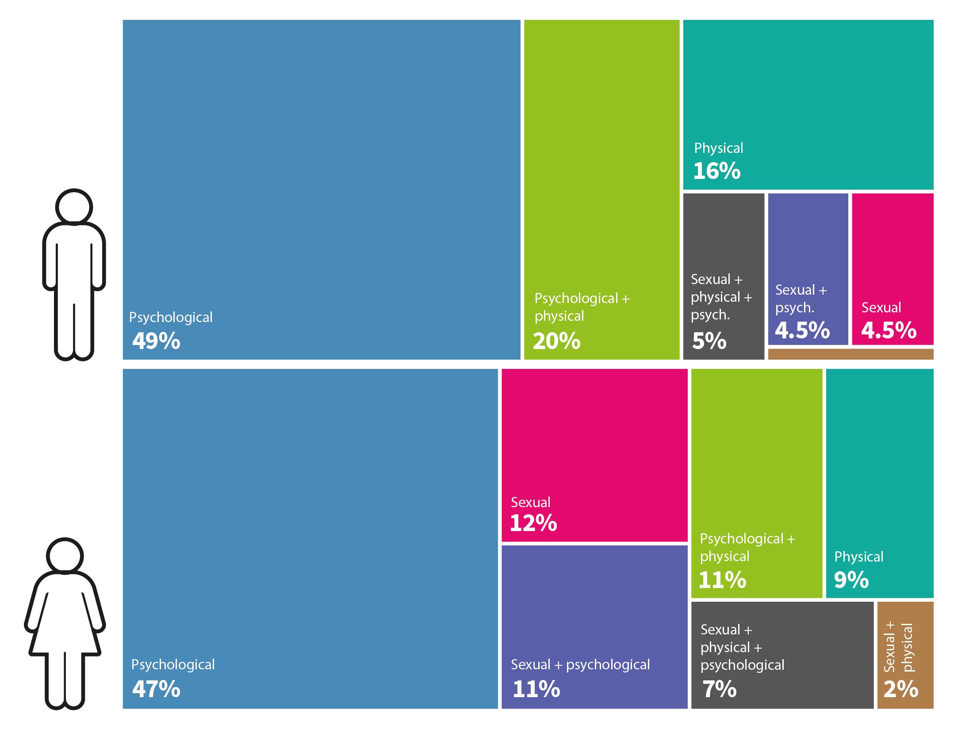
Experience of different forms of violence and harassment varies significantly by sex
Forms experienced by those who reported violence and harassment at work

Slide 11

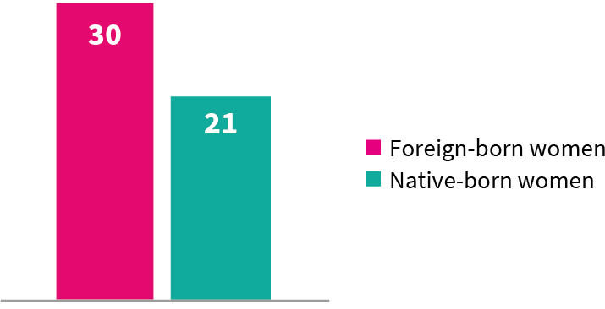
Foreign-born women are at higher risk of violence and harassment at work than native-born women
Percentage of WOMEN who reported experience of violence and harassment at work, by migrant status

Slide 12

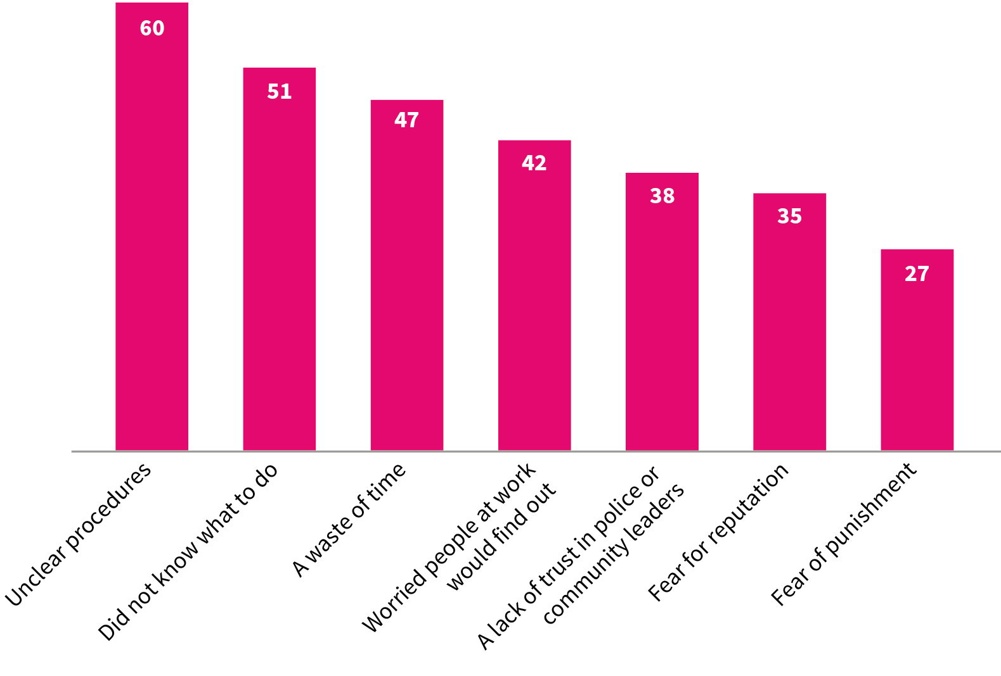
Reporting pathways should be clear, particularly for vulnerable groups
Percentage of FOREIGN-BORN WOMEN who had reported experience of violence and harassment at work who DID NOT tell someone about their experience, reason they did not tell someone

Slide 13
Questions

Slide 14
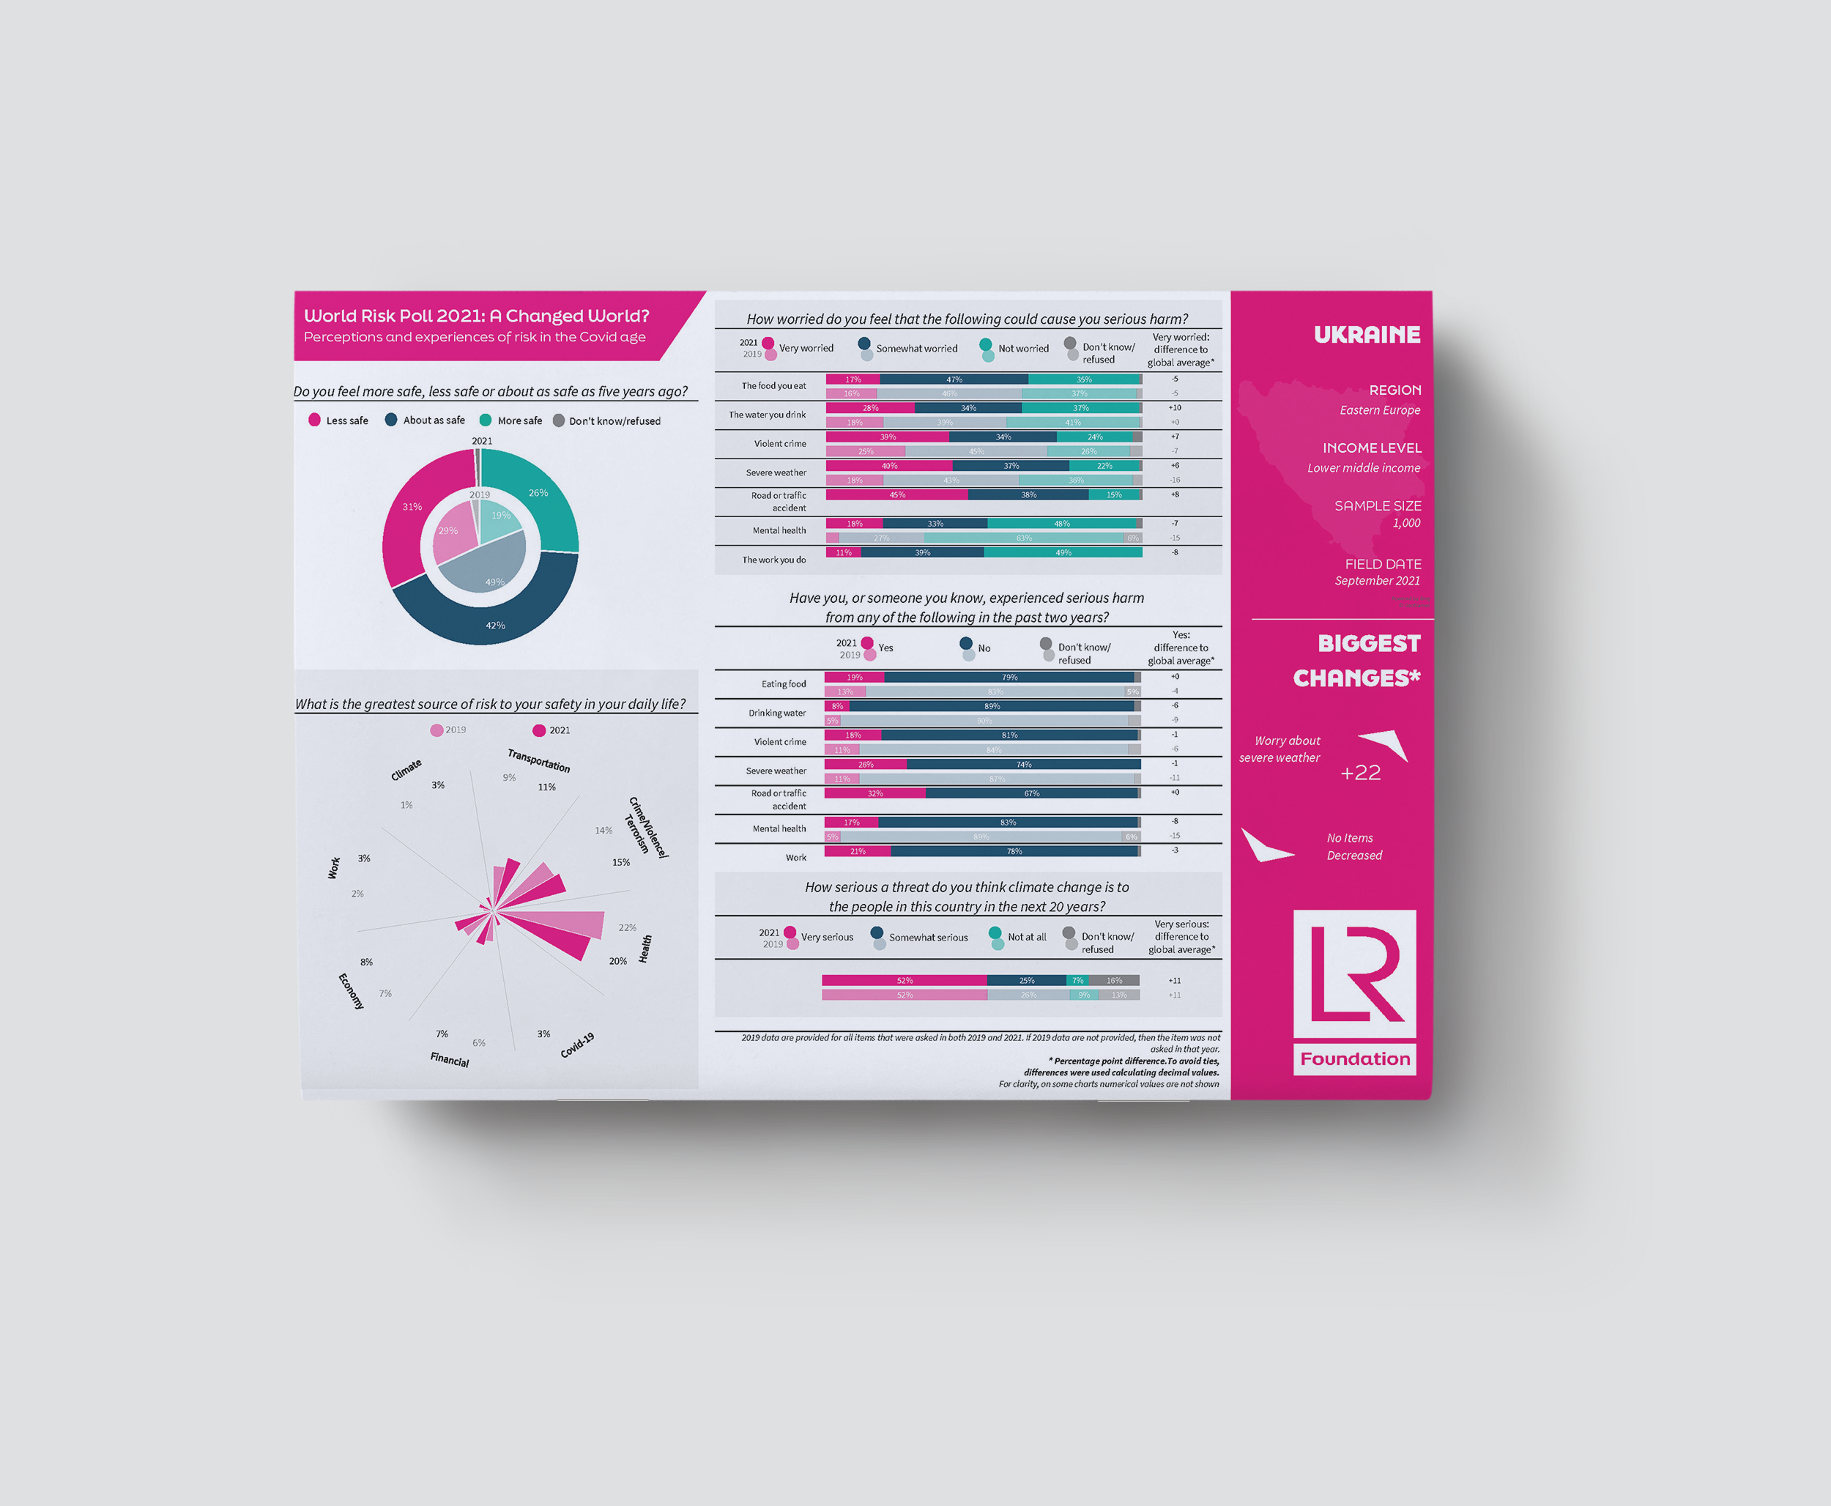
lrfworldriskpoll.com
Explore the poll – stories and visual snapshots
Download the full dataset
Apply for funding to turn the World Risk Poll into action
Queries to dagmara.karbowska@lr.org
lrfworldriskpoll.com
@LR_Foundation // #WorldRiskPoll

