Slide 1
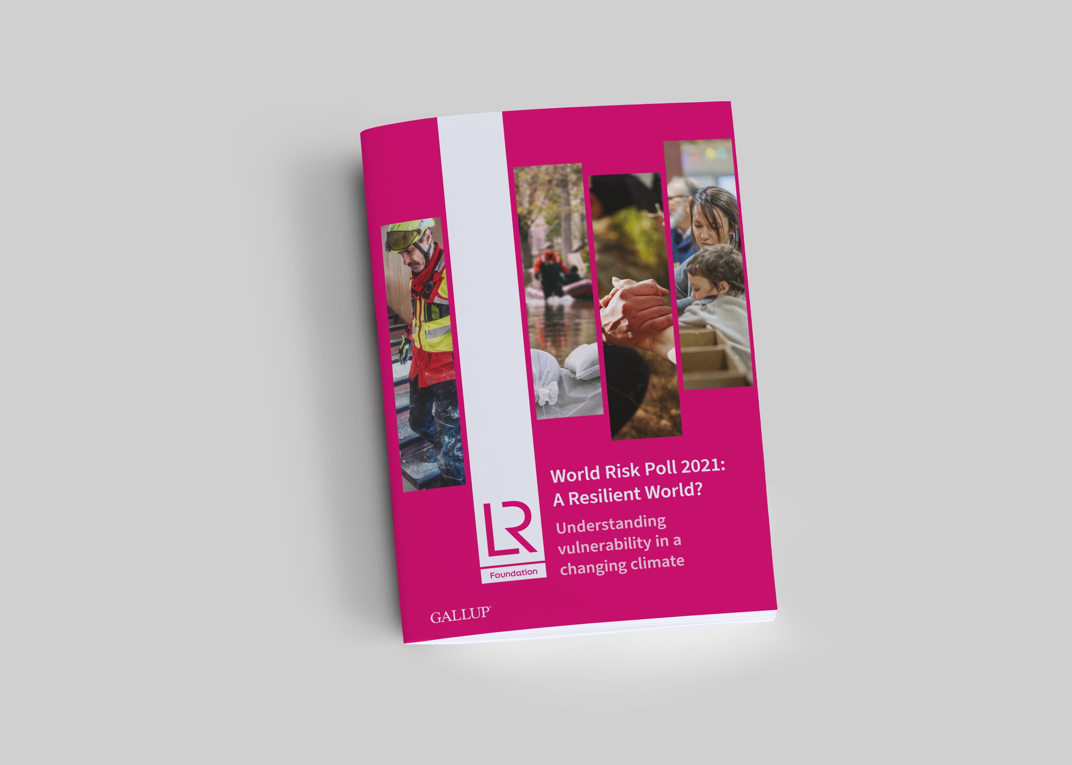
Call for Proposals (2 of 4)
World Risk Poll 2021:
A Resilient World?
Understanding vulnerability in a changing climate
lrfworldriskpoll.com
@LR_Foundation // #WorldRiskPoll

Slide 2
Lloyd’s Register Foundation
An independent global charity with a mission to engineer a safer world
  Unique structure and sole shareholder of Lloyd’s Register Group
  Work to reduce risk and enhance the safety of critical infrastructure
  Award grants and support work which helps us deliver our charitable mission
  Aim to improve safety through interventions that are driven by evidence of what works
We focus on the biggest safety challenges: Safety at sea, safety of digital systems, safety for a sustainable future, safety of food, skills for safety, safety of physical infrastructure, public understanding of risk.

Slide 3
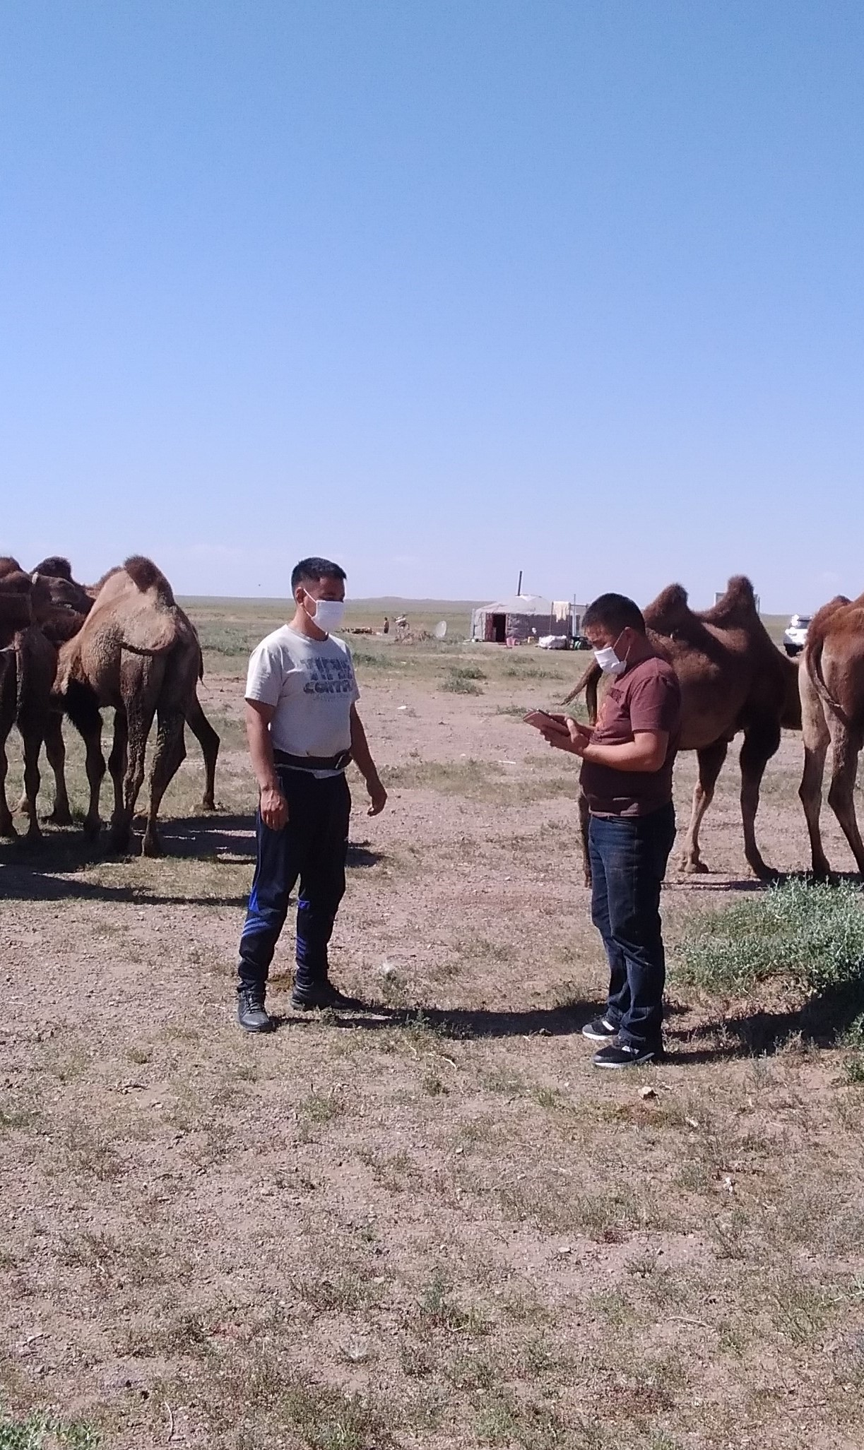
The Lloyd’s Register Foundation World Risk Poll
121 countries, 125000 interviews
  Assessing perception and experience of risk
  In places where little or no official data on safety exists
  Disaster resilience, violence & harassment at work, data privacy & artificial intelligence
Resilience Index
  Individual
  Household
  Community
  Social

Slide 4
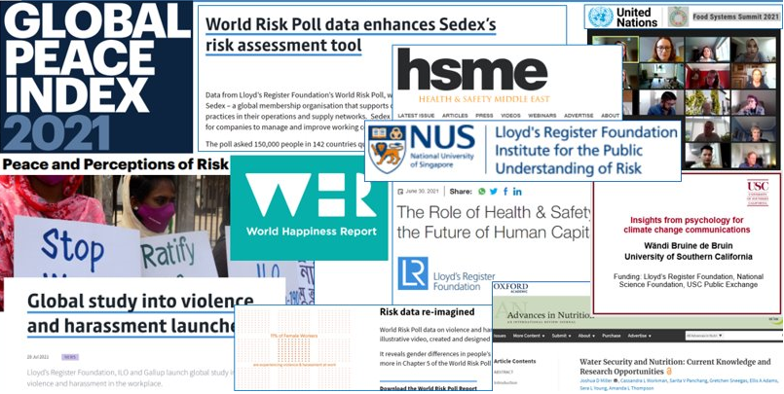
World Risk Poll 2019 Projects

Slide 5
World Risk Poll 2021 - Call for Proposals
Foundation strategic aim to maximise the impact of the Poll data
Second in a series of 4 calls linked to each 2021 World Risk Poll focus area
  Perceptions and experiences of risk in the Covid Age (call announcement)
  Global resilience - perceptions and experiences of disaster preparedness (call announcement)
  Perceptions of harm from AI and misuse of personal data (expected end Nov)
  Violence and harassment at work
Grant funding available for impactful research and interventions that utilise the Poll data and aim to improve global safety
Budget: upper limit of £250,000 for most projects but the Foundation may fund one larger, high impact project with a budget of up to £750,000.
Deadline of 31/12/2022 for applications
Prospective applicants must first register interest on Flexigrant

Slide 6
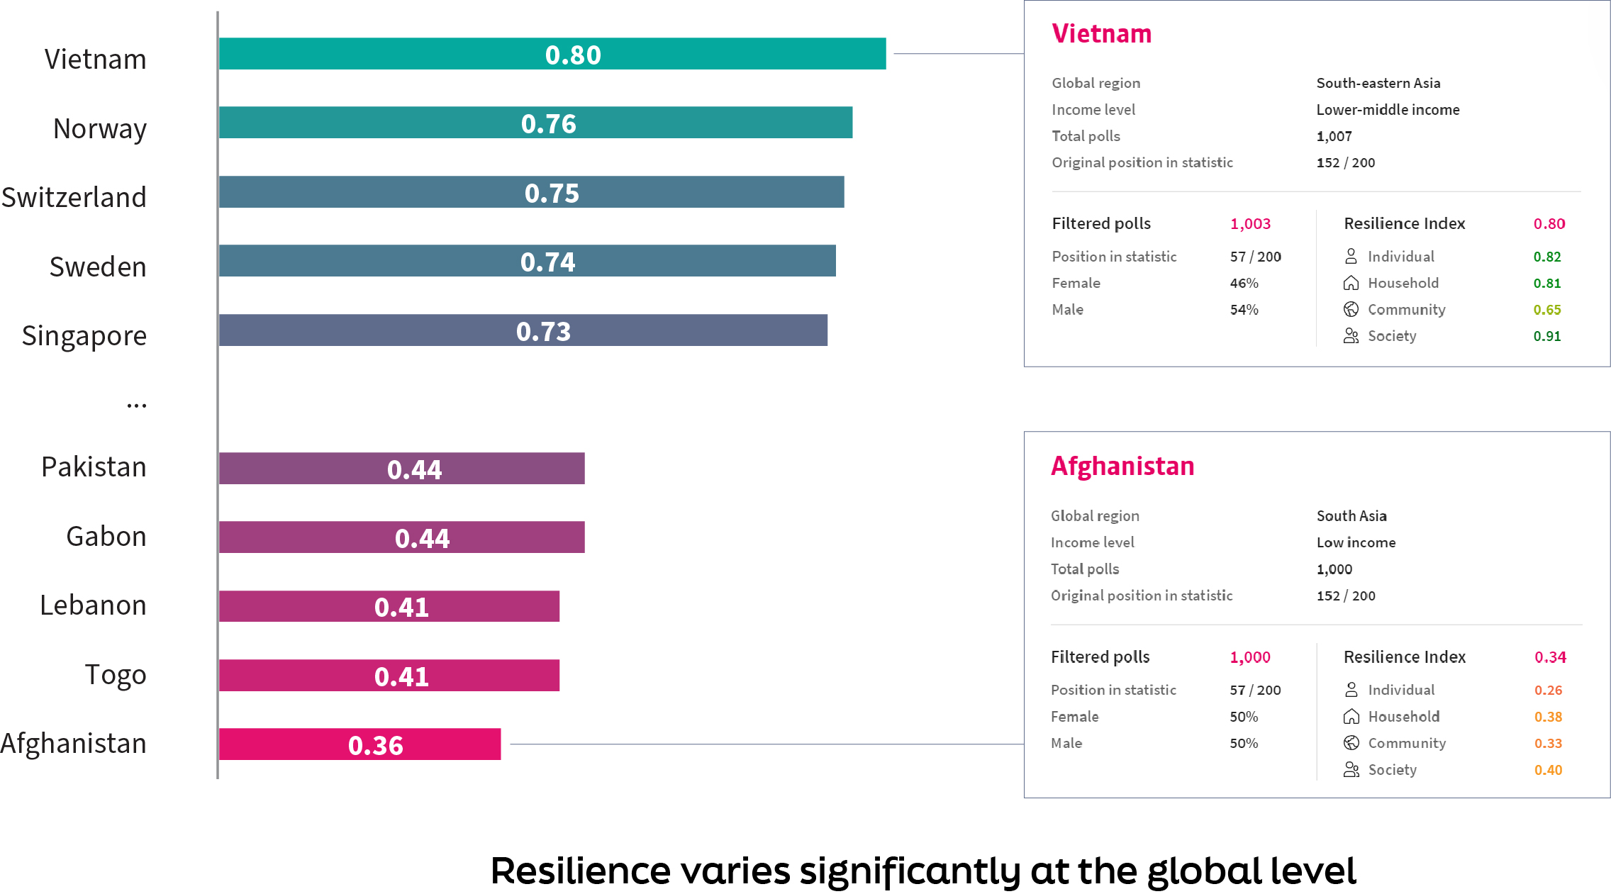
Resilience varies significantly at a global level

Slide 7
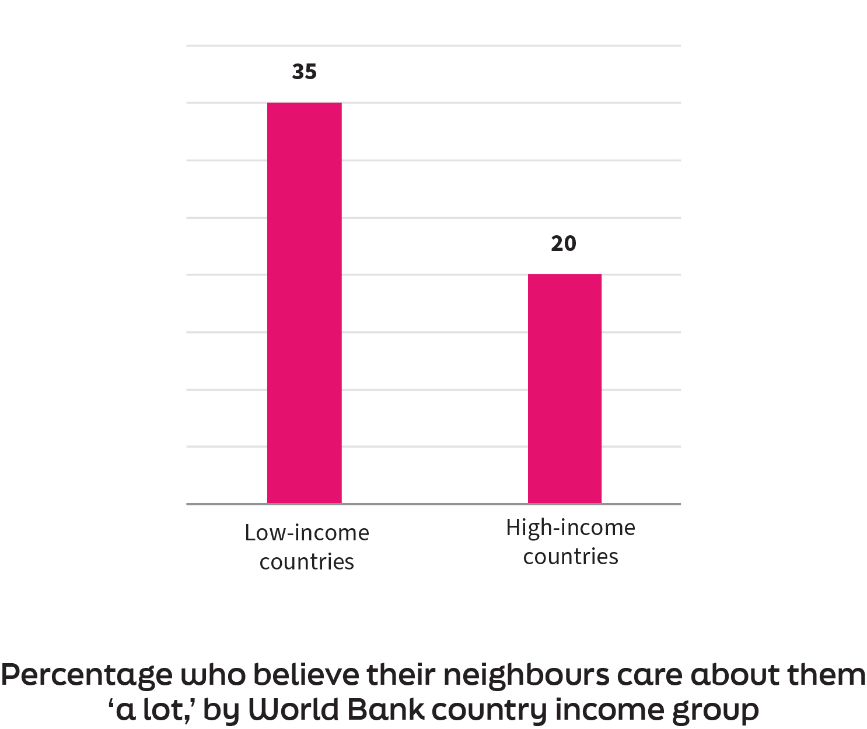
Community support can compensate for lower resilience on other dimensions

Slide 8
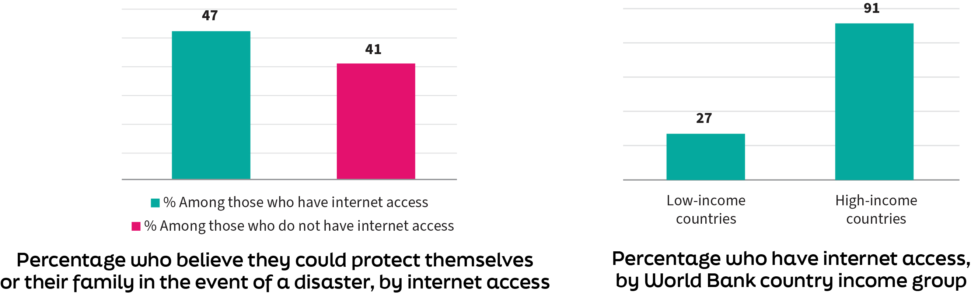
People with internet access feel more able to protect themselves

Slide 9
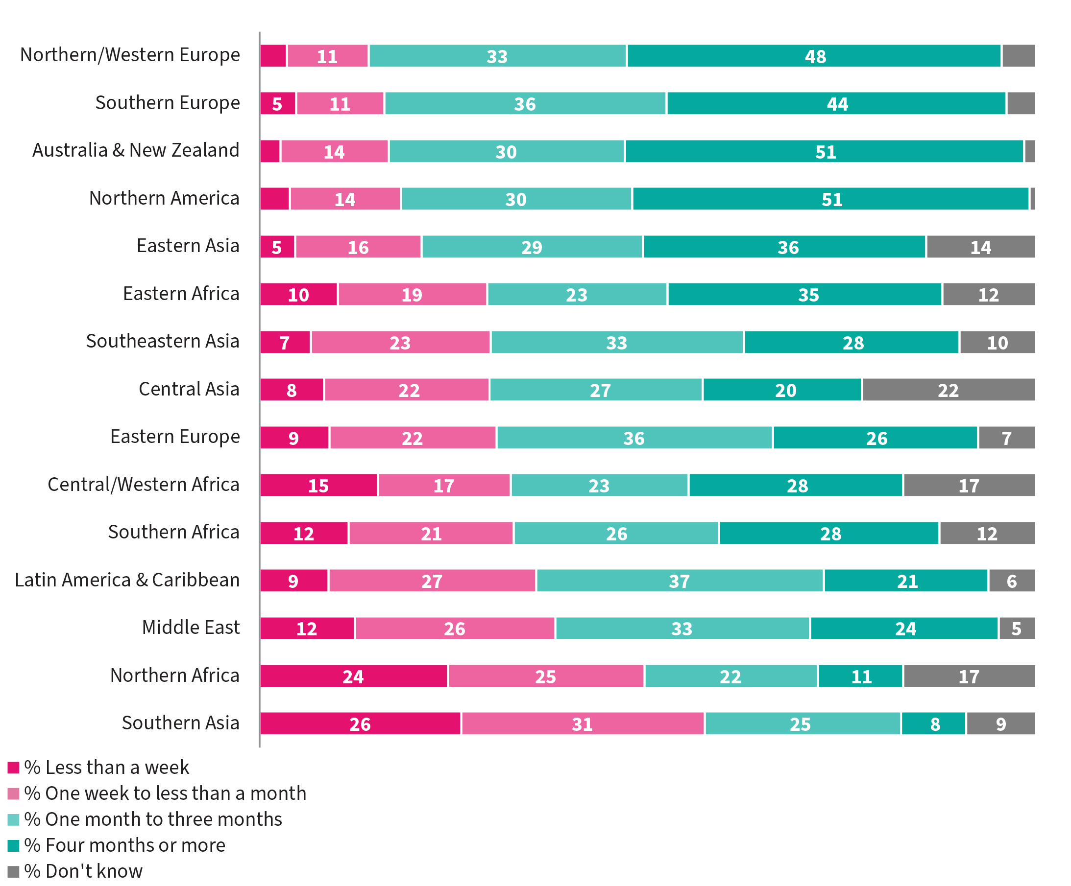
New measure reveals global financial vulnerability

Slide 10
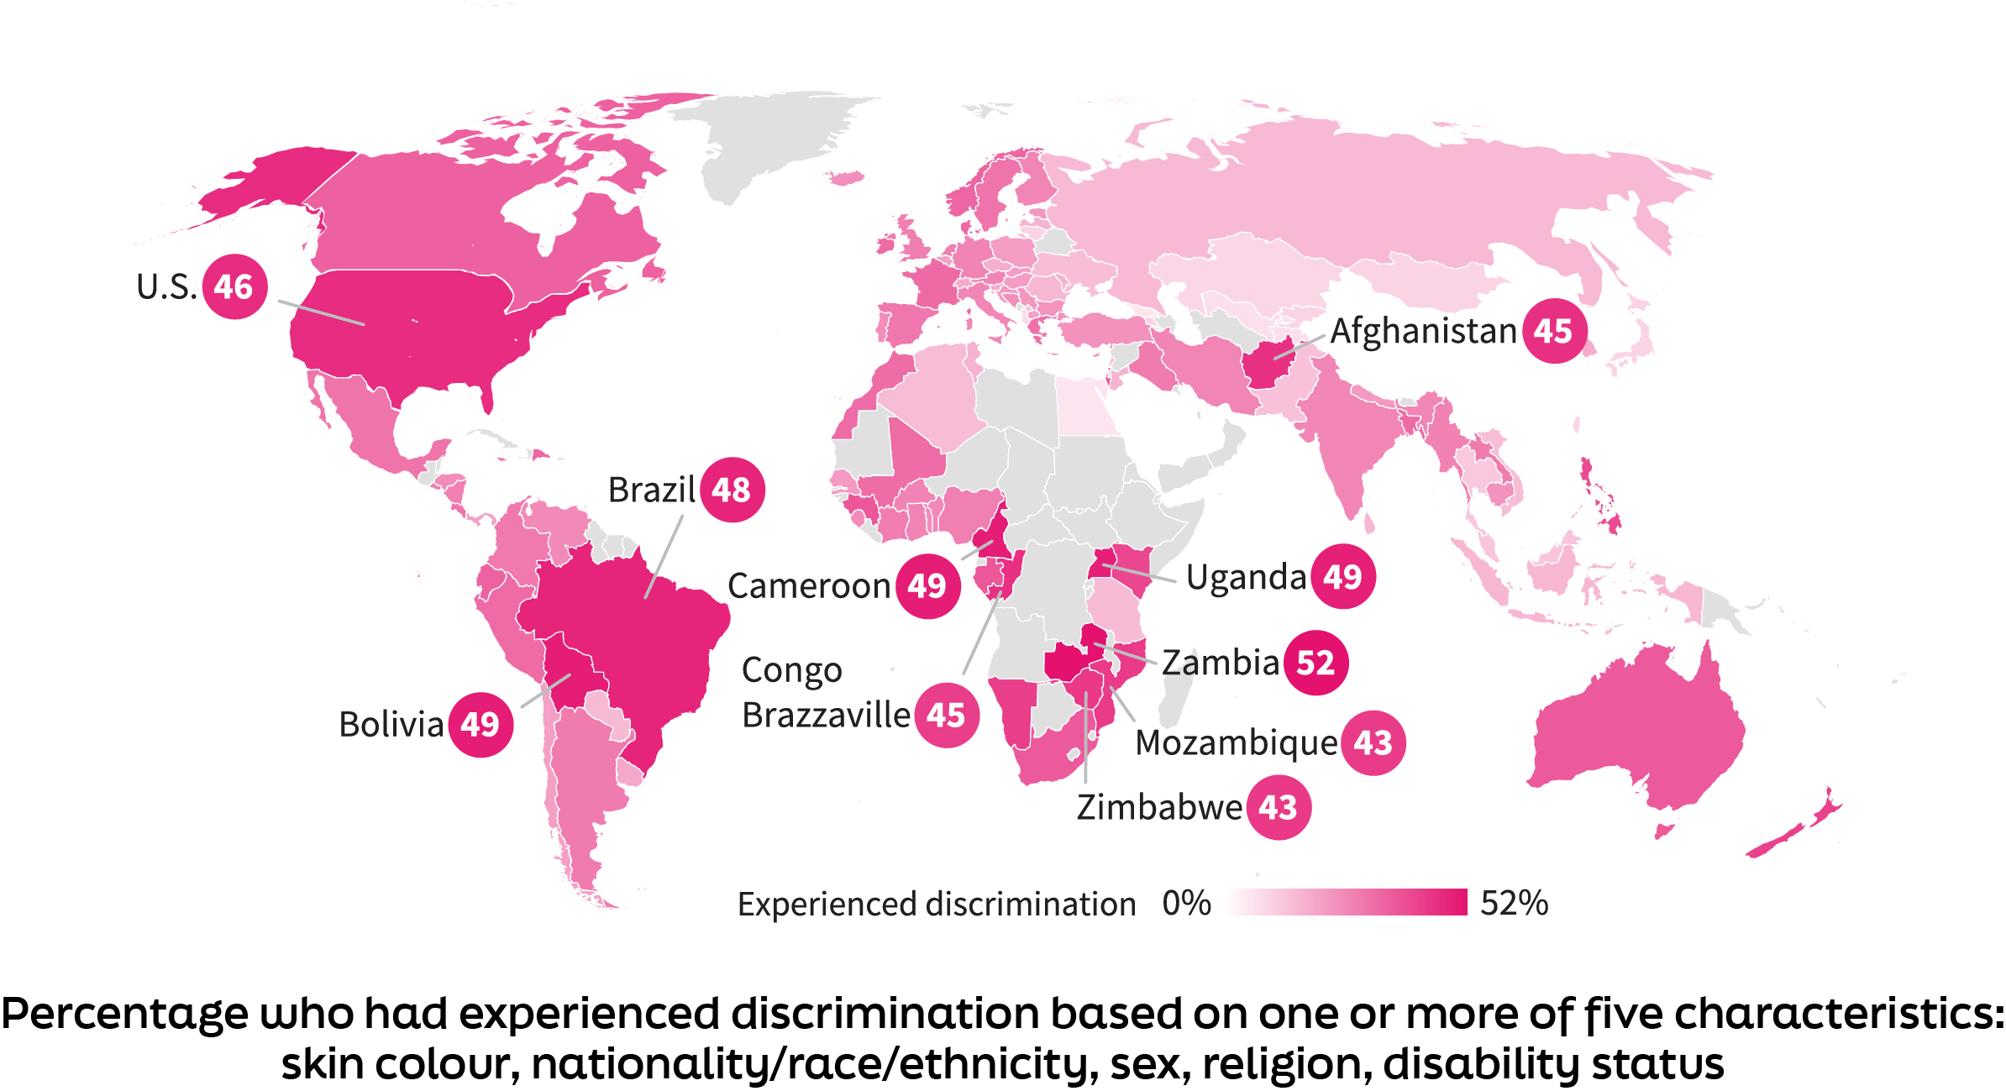
One in five globally has experienced discrimination

Slide 11
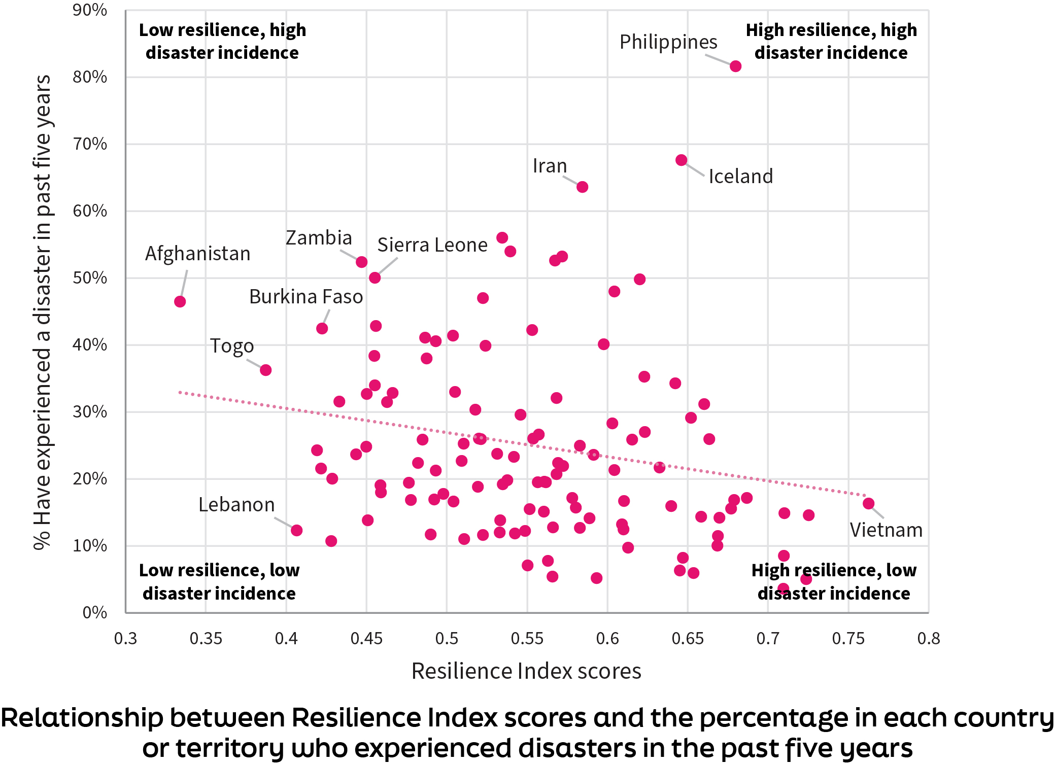
Countries experiencing most disasters have low resilience index scores

Slide 12
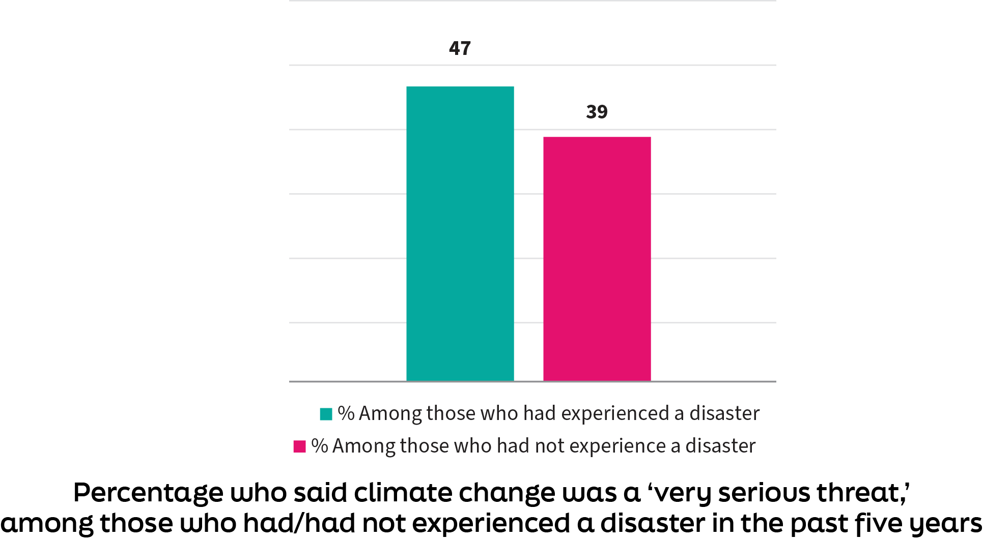
Severe-weather events – a motivation for being prepared?

Slide 13
Questions

Slide 14
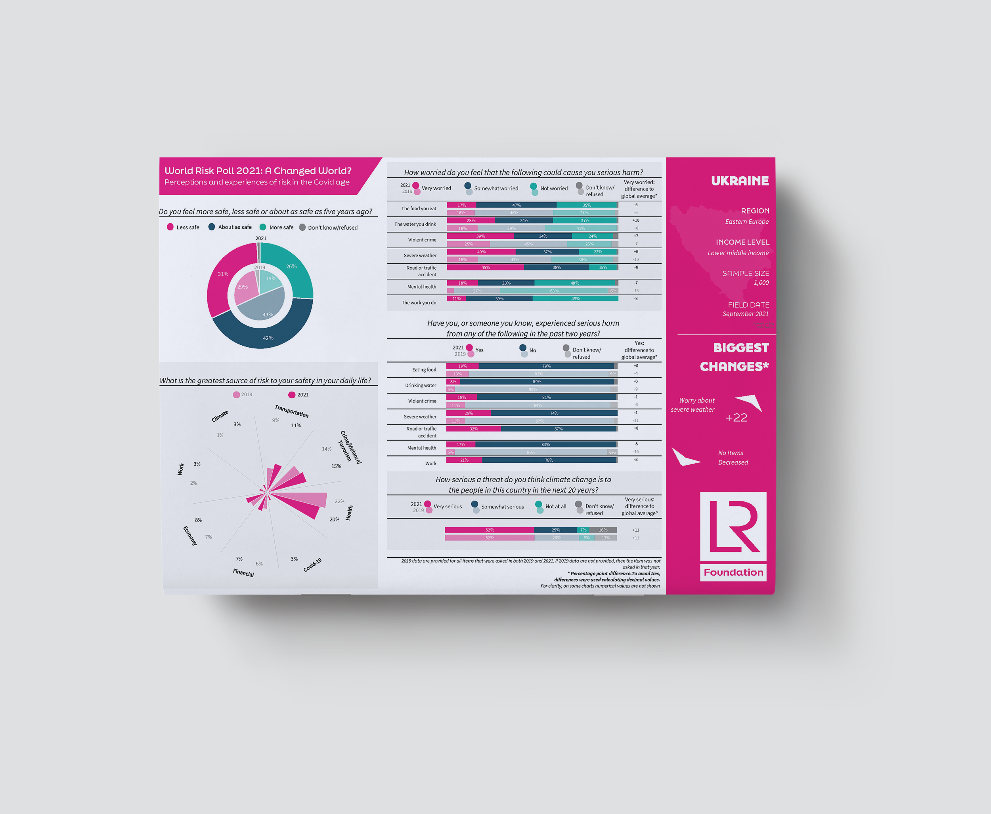
lrfworldriskpoll.com
Explore the poll – stories and visual snapshots
Download the full dataset
Apply for funding to turn the World Risk Poll into action
Queries to worldriskpoll@lrfoundation.org.uk
lrfworldriskpoll.com
@LR_Foundation // #WorldRiskPoll

